Slide 1
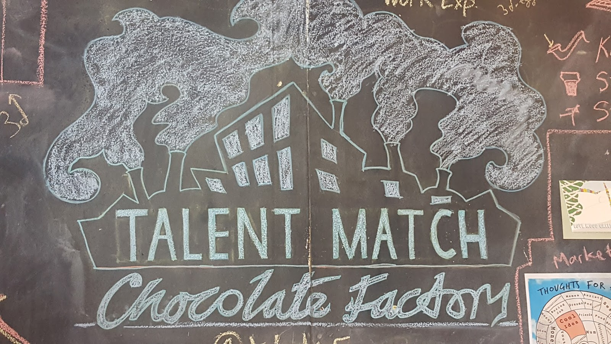
COLLAGE ARTS, LONDON

Slide 2
Young people are listened to and their needs are acknowledged and relationships develop.

Slide 3
They identify their skills and development needs, map their networks and plan to meet their goals

Slide 4
They recognise their achievements and develop their communication skills and self-awareness.

Slide 5
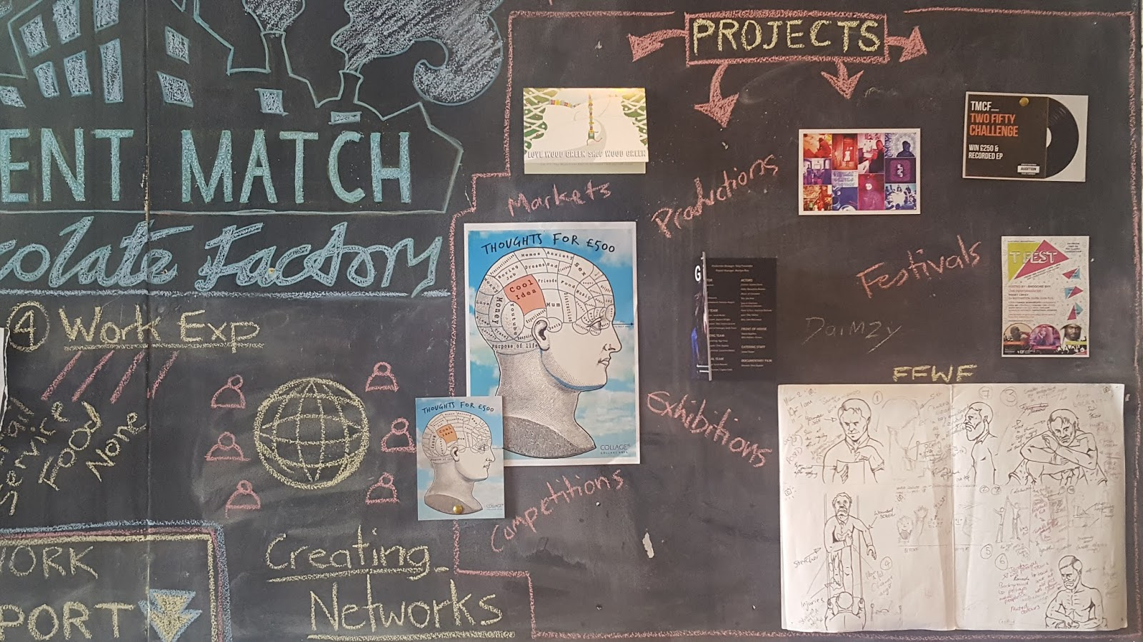
They learn and apply practical skills, gain feedback and experience working in a team on projects.

Slide 6
They explore the world of work, understand employers, industries and grow their networks.

Slide 7
They contribute to the economy, increase their skills and develop their emotional capabilities.

Slide 8
A great way for young people to express themselves positively through creativity.

