Slide 1
COGAME
Train the trainers
Budapest 2017
Game Design

Slide 2
Keep in mind!
Iterative design: a process focused on playtesting
A game is a game – have fun!
Less brainstorming more producing (ideas are „cheap”)
Learning by doing (theory is clean, practice is messy)

Slide 3
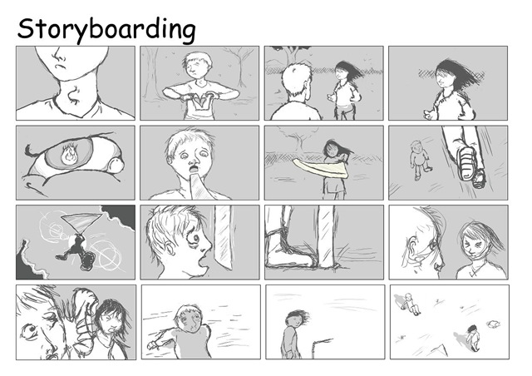
Storyboarding

Slide 4
Why do we need it?
Makes the production process easier
Best way to share your vision
Saves you time
Keeps you organized
A visual map about your game

Slide 5
How to make!?
Sketch out ideas for your story, world, scenes etc.

Slide 6
Steps
Choose the era/century (every detail counts)
Sketch your grand story line (conflict, an important event, which nations, empires are involved)
Make sure it’s logical and coherent
Draw sketches of scenes, of the end goal

