Slide 1
UNIT 3: Videogame production for VET

Slide 2
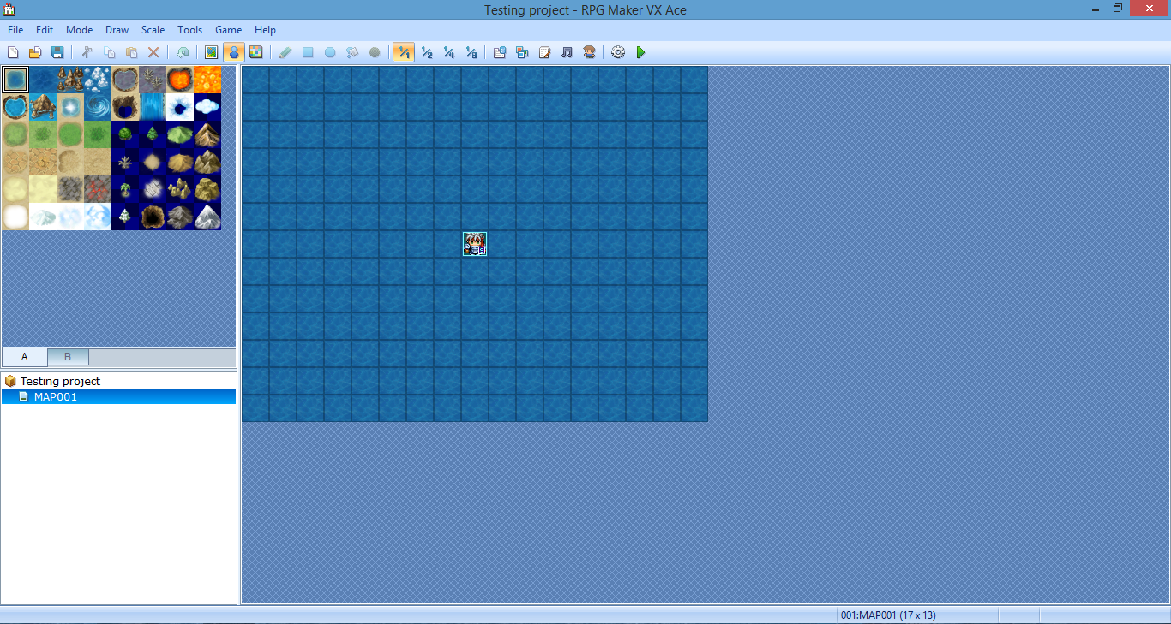
The production phase
It consists of “translating” the contents created during the design phase into a graphic environment and game mechanics through the use of a video game editor.
Narrative elements
Game mechanics
Graphics and audio

Slide 3
Parts of the production process
Collecting resources: sprites, character faces, icons, audio, etc.
Drawing maps (scenarios) with tiles
Editing objects: characters, items, enemies, tilesets, etc.
Programming events: dialogues, chests, cutscenes, etc.

Slide 4
First look at the video game editor

Slide 5
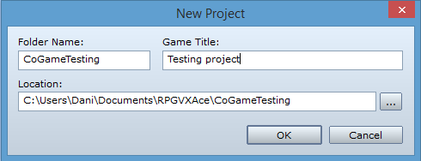
Knowing the tool:
RPG Maker MV interface
Starting a new project.
The map editor.
Database.
Folders for resources.
Other functionalities.

Slide 6
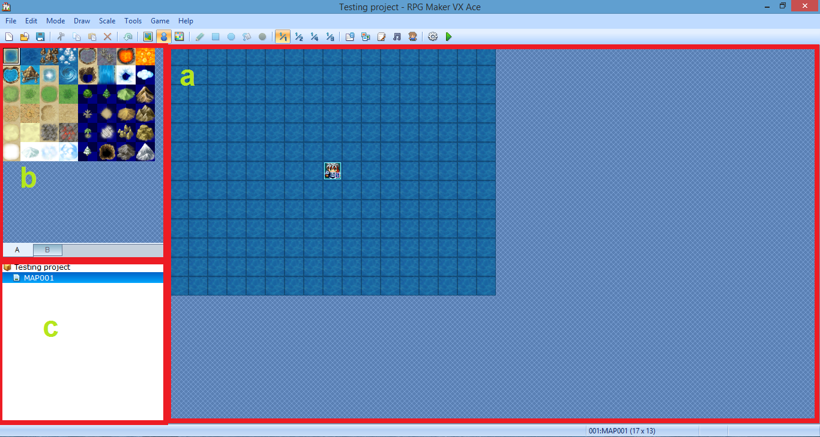
The map editor
Drawing area
Tiles
List of maps

Slide 7
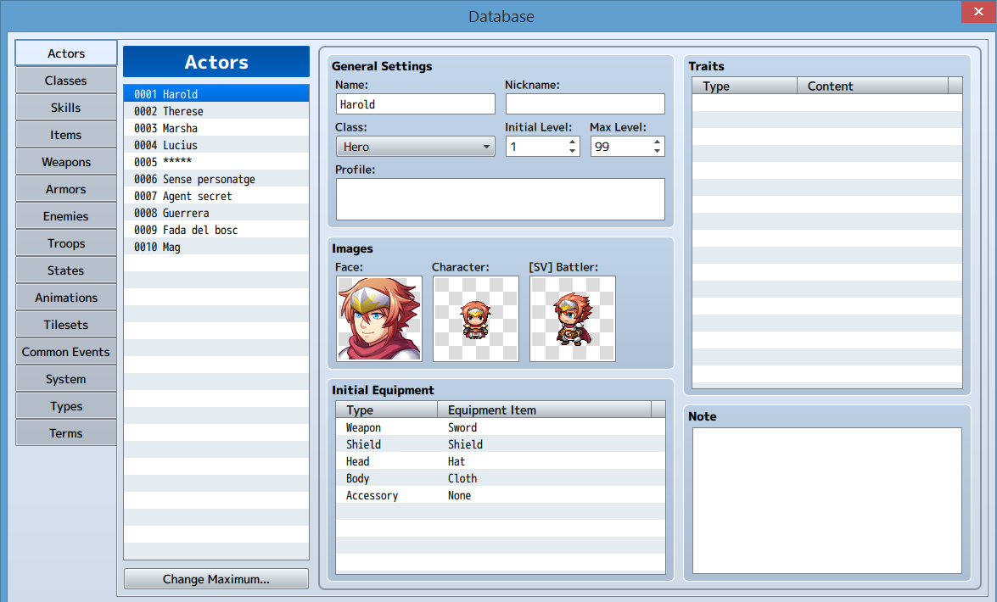
Database

Slide 8
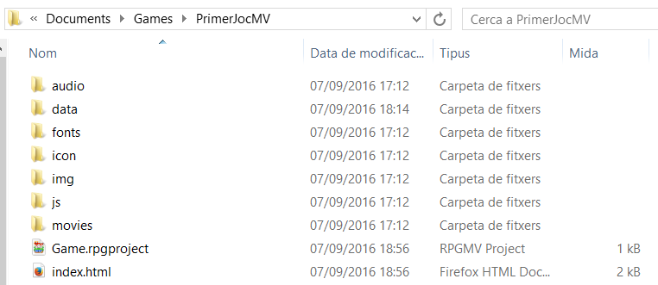
Resource folders
“img” folder for graphic resources.
“audio” folder for audio resources.
*From version 1.1, RPG Maker MV has a new resource manager included in the program.

Slide 9
Other functionalites
Character generator.
Script editor.
Exporting a game.

Slide 10
Collecting game resources

Slide 11
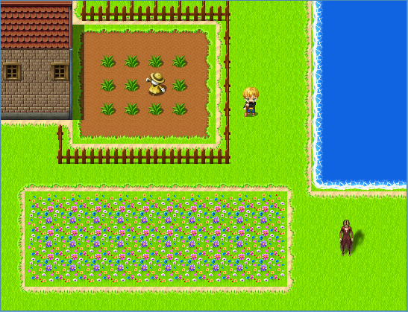
Game consistency
Something doesn’t look good...

Slide 12
RPG Maker MV resources
Characters (sprites).
Face graphics.
Parallaxes.
Titles.
Tilesets.
More graphic resources.
Audio resources: music and sound effects.
Movies.

Slide 13
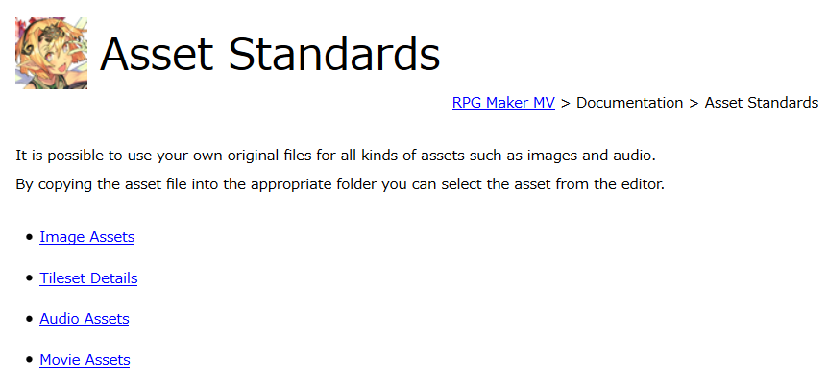
Asset standards
At the documentation you will find the standards for each kind of resource.

Slide 14
Drawing maps

Slide 15
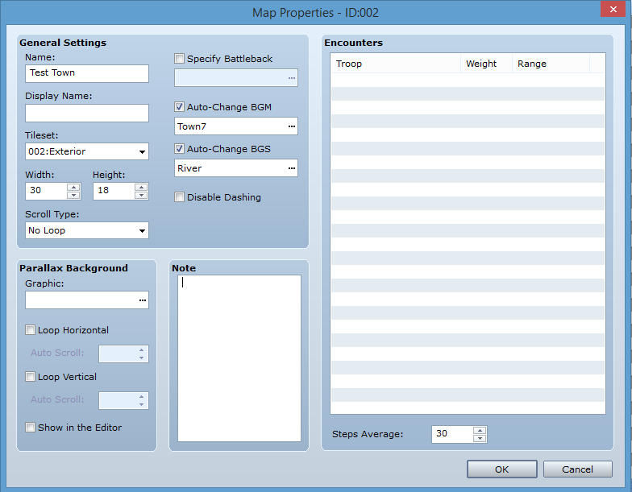
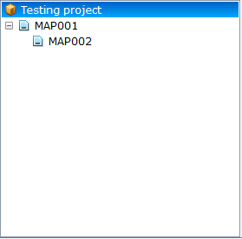
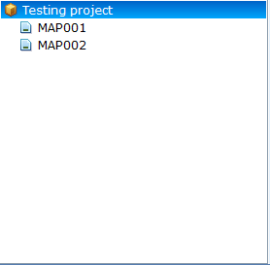
Create a new map

Slide 16
Drawing tools and layer system
Tiles are automatically placed on layers, unlike previous versions of RPG Maker.
There’s still the “events layer”.
Tips:
Right click selects a tile on the map.
Right click and dragging selects more than one tile. Also on the map.

Slide 17
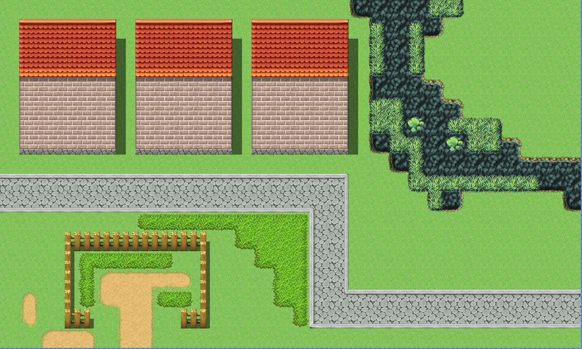
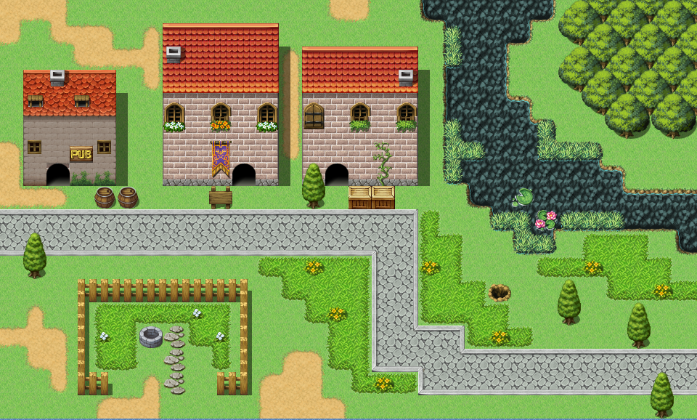
Drawing an outdoors map

Slide 18
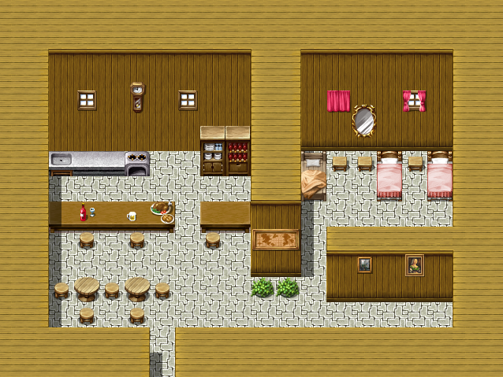
Drawing an indoors map

Slide 19
Creating game elements:
the database

Slide 20
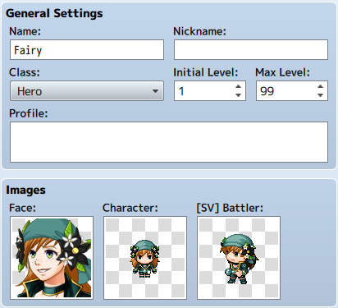
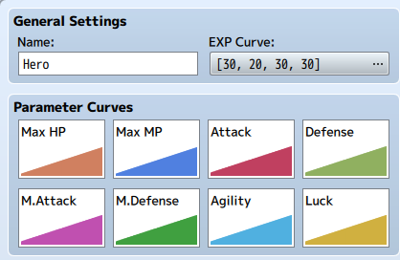
Creating a character
Tabs: “actors” and “classes”.

Slide 21
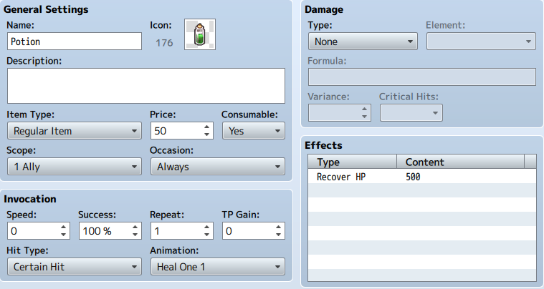
Items and equipment
Tabs: “items”, “weapons” and “armor”.

Slide 22
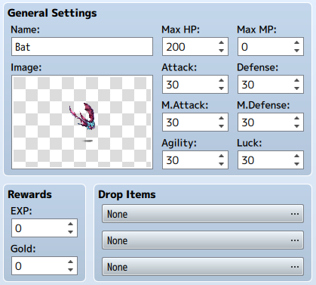
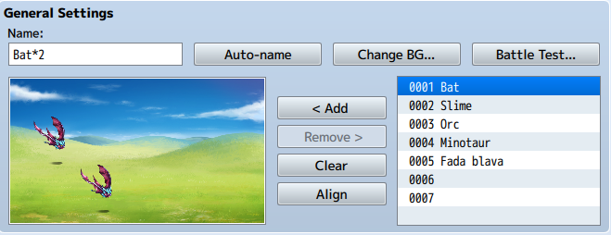
Enemies, battles and animations
Tabs: “enemies”, “troops” and “animations”.

Slide 23
Other database sections
Skills, states and types: further battle and game enhacements.
Tilesets: editing tiles for the maps.
Common events.
System: general options.
Terms: game vocabulary.

Slide 24
Programming events

Slide 25
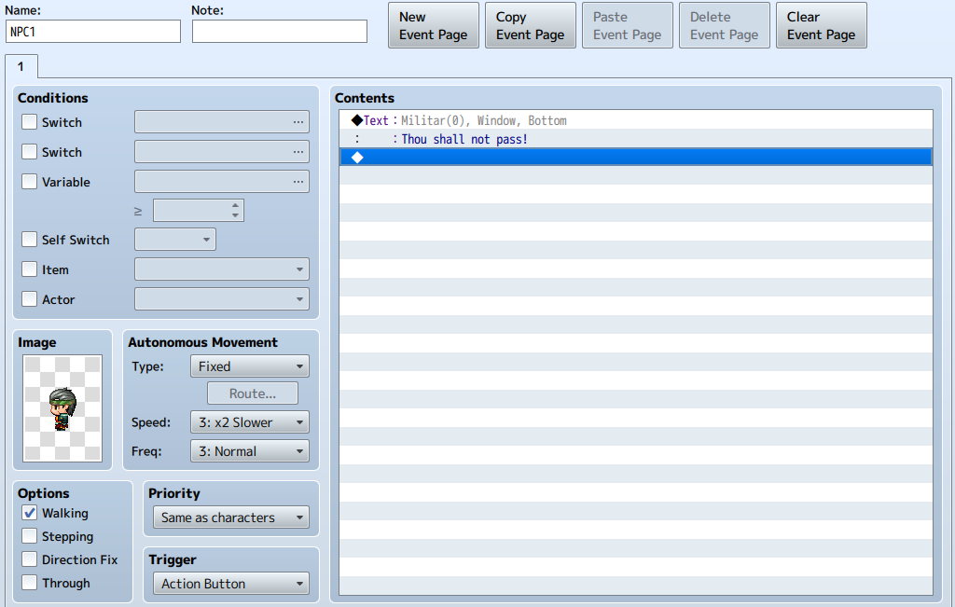
The event screen
Sections:
Conditions
Image
Autonomous movement
Options
Priority
Trigger
Contents
Pages

Slide 26
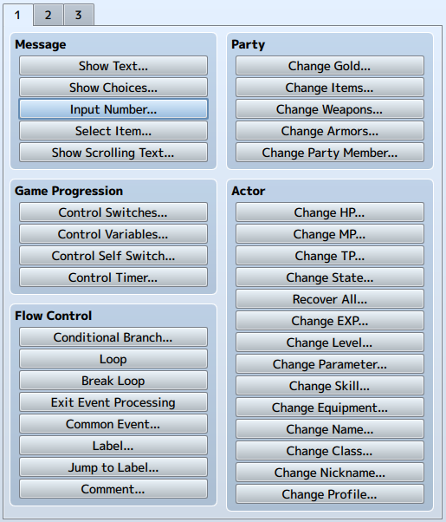
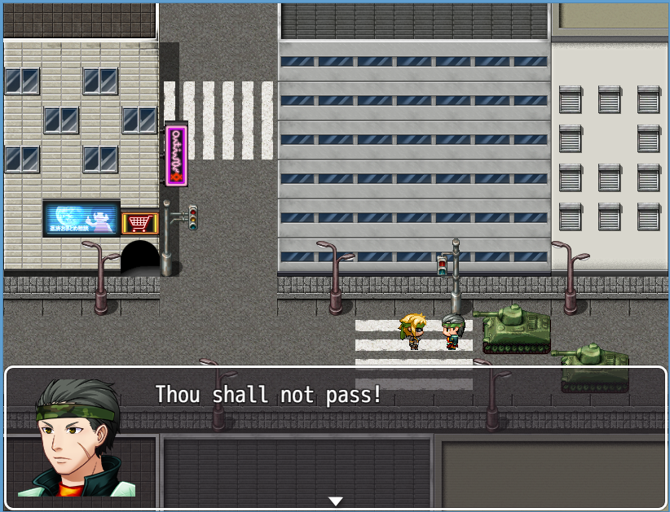
Event commands

Slide 27
Switches and variables
Switches and variables are the basic element for programming. They keep track of values that are used for the game mechanics.
Switches store a TRUE or FALSE value.
Variables store NUMBERS.
The value of a switch or a variable can be changed through the video game using event commands. For exemple, to know if a chest has an item or it has already been taken. The result, depending on the switch (true or false / open or closed) will change.

Slide 28
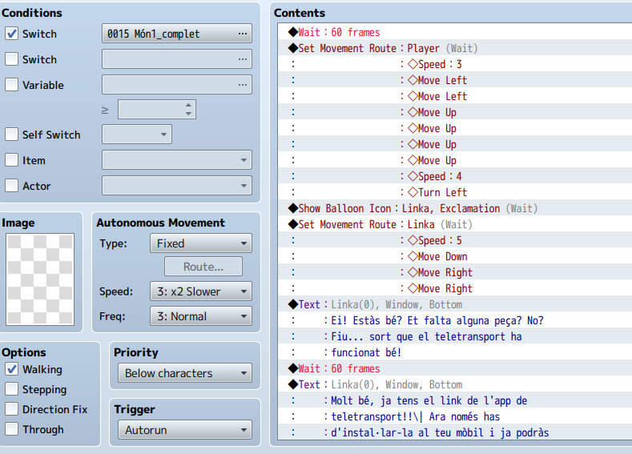
Creating a cutscene
Characters, NPCs and other elements of the game can be moved, accompained by other elements: text, animations, sound effects, etc. By using the events commands, sometimes combined with switches and variables, you can create an cutscene.

Slide 29
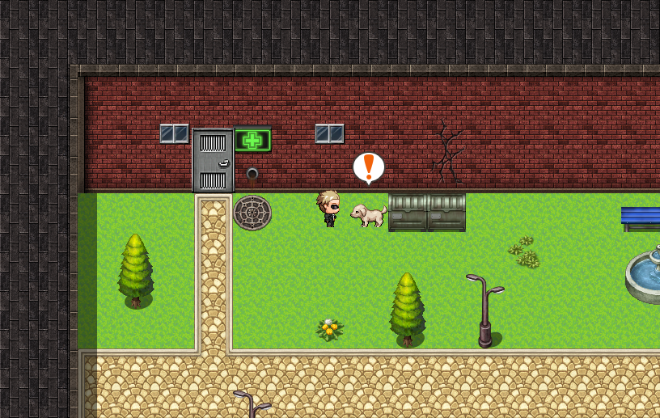

Slide 30
Thank you!

